Slide 1
Git Tutorial and Internals
January 16, 2025
Real-Time Operating Systems Laboratory,
Department of Electrical and Computer Engineering,
Seoul National University

Slide 2
Contents
Git Tutorials and Internals
Introduction
Basics of Versioning in Git
Basics of Sharing in Git
Internals of Git Versioning
Assignments

Slide 3
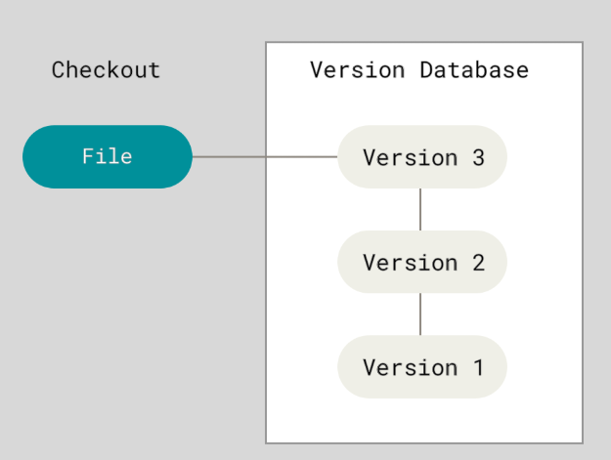
Version Control System
I. Introduction
Version control system
Is a system that stores changes to each version
Allows you to check out previous versions when needed
Notes:
그래서 소피는 이 컨테이너 기술을 자동차에

Slide 4
Git (1)
I. Introduction
Git is a type of version control system
Allows developers to manage versions locally on their computers
Provides the ability to synchronize versions with a server
Ensures collaboration and sharing across
Notes:
그래서 소피는 이 컨테이너 기술을 자동차에

Slide 5
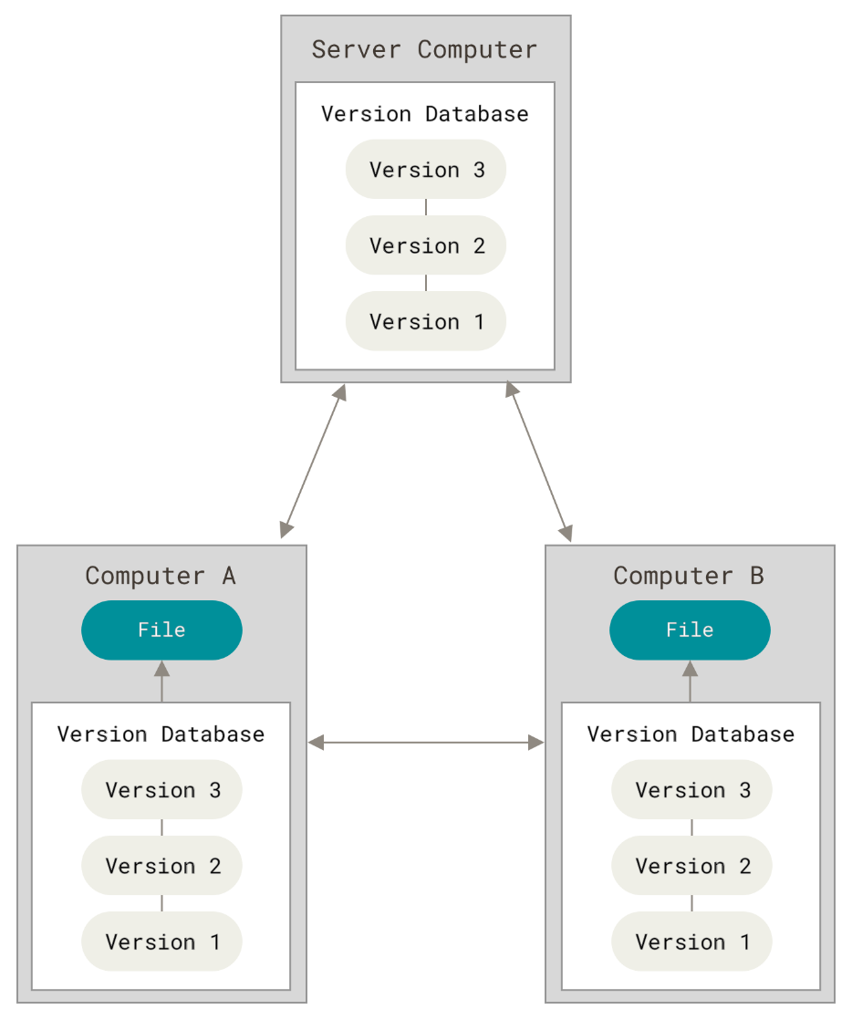
Git (2)
I. Introduction
Notes:
그래서 소피는 이 컨테이너 기술을 자동차에

Slide 6
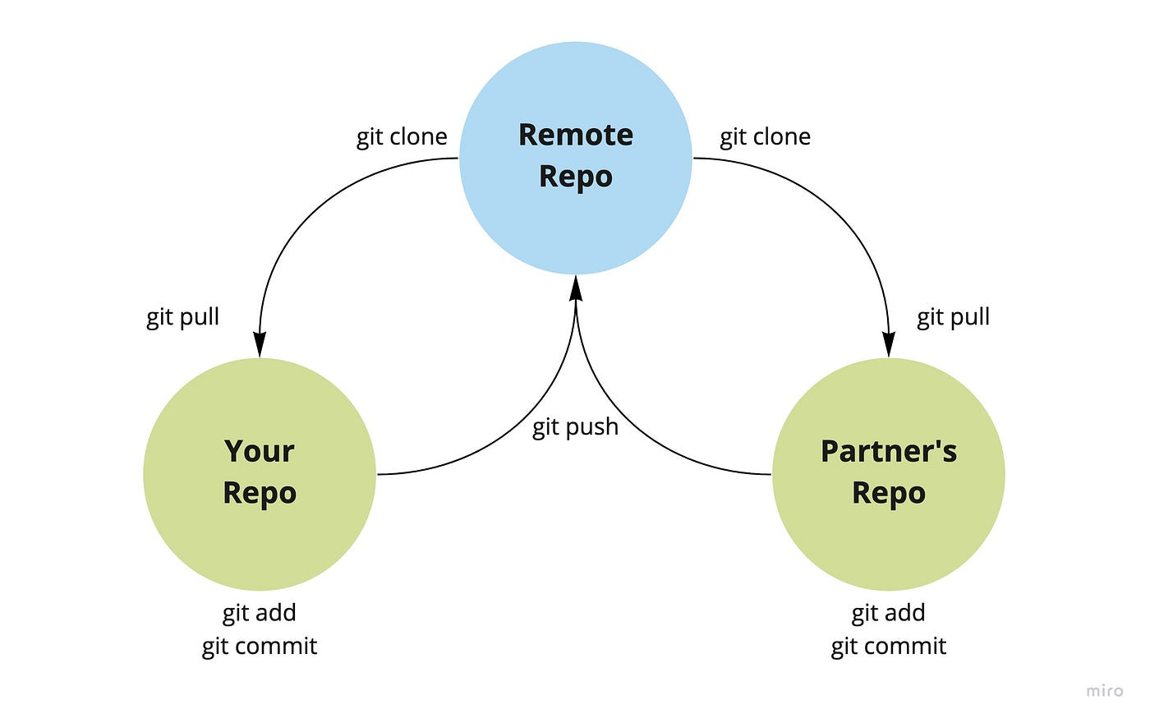
Git Learning Roadmap
I. Introduction
Versioning
Sharing
Collaboration
Notes:
그래서 소피는 이 컨테이너 기술을 자동차에

Slide 7
Today’s Learning Goals
I. Introduction
Versioning by git commit
Learn the foundation of git by creating git commits
Sharing by remote repositories
Discover how to share versions using remote repositories platform like GitHub
Deepening: internals of git commit
Explore how git saves changes during the commit process
Notes:
그래서 소피는 이 컨테이너 기술을 자동차에

Slide 8
Setting up Git
II. Basics of Versioning in Git
Installing git
Git Installation Guide (https://git-scm.com/book/ko/v2/시작하기-Git-설치)
Setting up first git repository
Git repository is a .git folder inside a project
Where git tracks history of changes in a project
cd /path/to/my/codebase
git init [<directory>]
Notes:
그래서 소피는 이 컨테이너 기술을 자동차에

Slide 9
Git Versioning (1)
II. Basics of Versioning in Git
Demonstration
버전의 생성 - 생활코딩https://opentutorials.org/course/3839/22592
Notes:
그래서 소피는 이 컨테이너 기술을 자동차에

Slide 10
Git Versioning (2)
II. Basics of Versioning in Git
Staging area
Represents a space where changed files are prepared before commit
Git commit
Represents a snapshot of the project’s state
A snapshot captures all current file at a specific point in time
Notes:
Git add, commit에서 자주 쓰이는 옵션에 대한 설명 및 시연하기

Slide 11
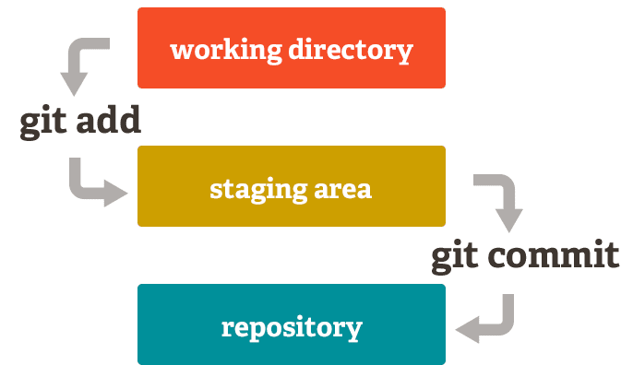
Git Versioning (3)
II. Basics of Versioning in Git
Notes:
Git add, commit에서 자주 쓰이는 옵션에 대한 설명 및 시연하기

Slide 12
Git Versioning (4)
II. Basics of Versioning in Git
Commands for git versioning
Stage files: git add [-p] [-A] [--] [<pathspec>]
git add files*
git add . or git add -A
Commit changes: git commit [-a] [--amend] [-m <msg>]
git commit
git commit –-amend
git commit –m “this is my first commit”
Notes:
Git add, commit에서 자주 쓰이는 옵션에 대한 설명 및 시연하기

Slide 13
Remote Repositories (1)
III. Basics of Sharing in Git
While sharing changes directly between individual repositories is possible, it is not recommended
Directly sharing changes can make changes inaccessible when offline
Using an intermediate repository accessible to all collaborators is the preferred approach
Notes:
그래서 소피는 이 컨테이너 기술을 자동차에

Slide 14
Remote Repositories (2)
III. Basics of Sharing in Git
Notes:
그래서 소피는 이 컨테이너 기술을 자동차에

Slide 15
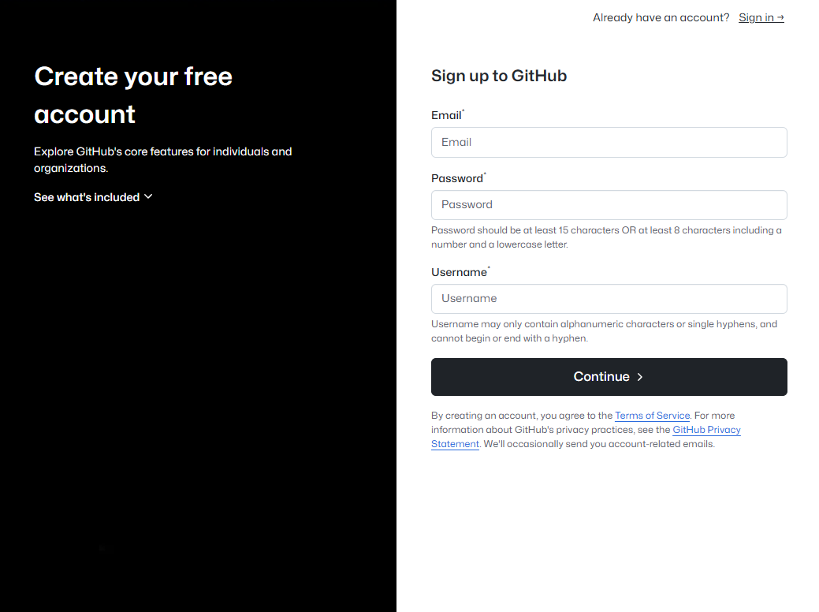
Setting up GitHub
III. Basics of Sharing in Git
Notes:
그래서 소피는 이 컨테이너 기술을 자동차에

Slide 16
Connecting to GitHub
III. Basics of Sharing in Git
Commands for remote repositories
Link repository: git remote add [<options>] <name> <url>
git remote add origin https://github.com/SNU-RTOS/ cloud-native-training.git
git remote –v for list of remote repositories
Push changes: git push [<repository> [<refspec>…]]
git push –u origin main
git push
Clone repository: git clone [<repository>][<directory>]
git clone https://github.com/SNU-RTOS/cloud-native-training.git
Pull updates: git pull

Slide 17
Internals of Git Commit (1)
IV. Internals of Git Versioning
Resources for deeper understanding
Internals of git add https://opentutorials.org/course/2708/15238
Internals of git commit https://opentutorials.org/course/2708/15240

Slide 18
Internals of Git Commit (2)
IV. Internals of Git Versioning
Sample Code
echo 'version 1' > test.txt
git hash-object -w test.txt
find .git/objects -type f
git update-index --add --cacheinfo 100644 \ <object-hash> test.txt
git write-tree
git cat-file -p <tree-hash>
echo 'First commit' | git commit-tree <tree-hash>
echo 'Second Commit' | git commit-tree <another-tree-hash> -p <parent-commit-hash>
git log --stat <commit-hash>

Slide 19
Internals of Git Commit (3)
IV. Internals of Git Versioning
Internals of staging and commit
git add [<filename>]
Moves changes to the staging area by creating a blob object in git's object database
Combination of git hash-object & git update-index
git commit
Creates a tree object that represents the state of the repository, including all staged blobs
Combination of git write-tree & git commit-tree
Both blob objects and commit objects are uniquely identified by SHA-1 hash, ensuring traceability
Notes:
이 사이 테스트할 커맨드들 넣기

Slide 20
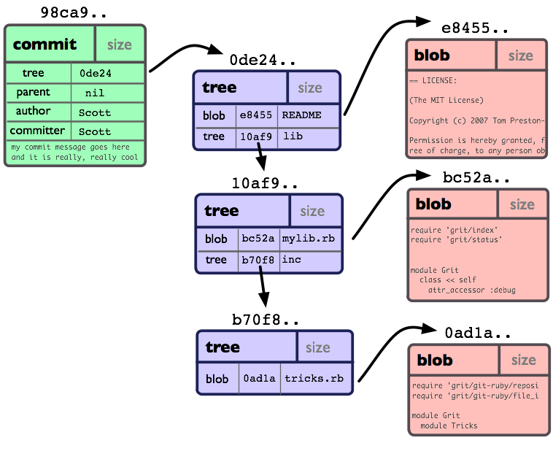
Internals of Git Commit (4)
IV. Internals of Git Versioning
Source: Maintain Hoon

Slide 21
Assignments
V. Assignments
Using git to your own project
Initialize a git for an existing project and push it to GitHub
Advanced commands
Practice git pull, git reset, git diff, git checkout

